Slide 1

Enhancing Person-Centred Care

Slide 2

Very Good
Very Poor

Slide 3
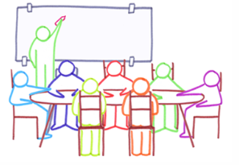
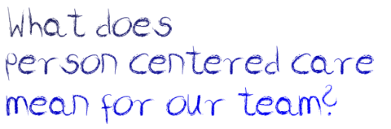

Slide 4
What is person-centredness?
“…care that is respectful of and responsive to individual patient preferences, needs and values, ensuring that patient values guide all clinical decisions”
Involving users of health and social services as equal partners in planning, developing and monitoring care
Considering the person’s point of view and being respectful
Considering people’s desires, values, family situations and social circumstances
IOM. (2001). Crossing the Quality Chasm: A new health system for the 21^{s} century. Washington, DC: National Academy Press.
Notes:
https://healthinnovationnetwork.com/system/ckeditor_assets/attachments/41/what_is_person-centred_care_and_why_is_it_important.pdf

Slide 5
Person-Centredness Principles
Support persons to make informed decisions
Person is a partner in their own health care
Change in behavior and mindset supported by a system
Offering coordinated care, support or treatment
Affording people dignity, respect and compassion
Collaboration between person, their family and staff
Supporting people to recognize and build on strengths, preferences
Appreciation and respect for unique contribution people make
Offering personalized health and social care
HSE – QID (2016a). Person-Centred Principles and Person-Centred Practice Framework
Notes:
https://www.hse.ie/eng/staff/resources/changeguide/resources/person-centred-principles-and-person-centred-practice-framework.pdf

Slide 6
The Ladder of Engagement and Participation
Devolving
Collaborating
Involving
Consulting
Informing
Placing decision-making in the hands of the community and individuals
Working in partnership with communities and patients in every aspect of the decision including development of alternatives and identification of the preferred solution
Working directly with community and patients to ensure concerns and aspirations are constantly understood and considered
Obtaining community and individual feedback on analysis, alternatives and/or decisions
Providing communities and individuals with balanced and objective information to assist them in understanding problems, alternatives opportunities and solutions
NHS England. The “Ladder of engagement and Participation”
Notes:
https://www.hse.ie/eng/staff/resources/changeguide/resources/person-centred-principles-and-person-centred-practice-framework.pdf

Slide 7
Patient Engagement Continuum
Levels of Engagement
Consultation
Involvement
Partnership& Shared Leadership
Direct Care
Patients receive information about a diagnosis
Patients are asked about their preference in treatment plans
Treatment decisions based on patient preferences, medical evidence & clinical judgement
Organizational design & governance
Organization surveys patients about their care experience
Hospitals involve patients as advisors or advisory council members
Patients Co-lead hospital safety and quality improvement committees
Policy Making
Public Agency conducts focus groups with patients to ask their opinion
Patient recommendations about research priorities used by public agency to make funding decisions
Patient representation on committee that decides how to allocate resources to health programmes
Factors Influencing engagement:
Patient: (beliefs, culture, health literacy, education)
Organization: (policies, Culture, procedures)
Society: (Social norms, regulations, policy)
European Respiratory Society. Commentary on "Engagement as an Element of Safe Inpatient Psychiatric Environments": Engagement Is Psychiatric-Mental Health Nursing - Scientific Figure on ResearchGate. Available from: https://www.researchgate.net/A-multidimensional-framework-for-patient-and-family-engagement-in-health-and-health-care_fig1_279990712

Slide 8
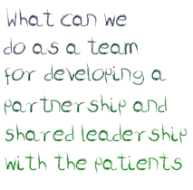
Partnership & Shared Leadership
Partnership & Shared Leadership
Involvement
Consultation

Slide 9




The Irish Context: Patient Experience Survey 2017
Lowest Rated Areas
Hospital Admission
Care on the Ward
Examinations, Diagnosis &
treatment
Discharge or Transfer
Waiting time for
admission
Hospital Food
Time to discuss care and
treatment with a doctor
Educating patients about medication side effects
Notes:
https://www.patientexperience.ie/app/uploads/2018/02/NPES-National-Report-2017-WEB.pdf

Slide 10
Improving the Patient Experience
Notes:
https://www.patientexperience.ie/app/uploads/2018/02/NPES-National-Report-2017-WEB.pdf

Slide 11
Encouraging Person Centred Thinking

Slide 12


What are the top 3 questions I should ask myself to be more person centred?
What are the top 3 questions I should encourage the patient to ask me to become more person centred?

Slide 14
Activity: Emotional Journey Map

Slide 15




Emotional State
Arrival
Registration
Waiting
Consultation
Lab tests
Pharmacy
Departure
Stressed
Relaxed

Slide 16

Outcomes
Individuals are empowered and treated with dignity
Care and support plans are focused on the long term goal and lifestyle
Family engagement
Transparent and clear processes
Differences recognised and respected
Individuals make informed choices and accept related risks
Positive and solution focused attitude
Patients viewed as equal and active partners
Privacy is respected
Notes:
https://www.lwb.org.au/assets/Uploads/person-centred.pdf

Slide 17
Session outcomes?
What can we start doing as a team to
become more person-centred?

